Slide 1
Derivative Securities
Charles Nadeau
University of Göteborg
Spring 2016

Slide 2
Model of the Behavior of Stock Prices
Chapter 13

Slide 3
Categorization of Stochastic Processes
Discrete time; discrete variable
Discrete time; continuous variable
Continuous time; discrete variable
Continuous time; continuous variable

Slide 4
Modeling Stock Prices
We can use any of the four types of stochastic processes to model stock prices
The continuous time, continuous variable process proves to be the most useful for the purposes of valuing derivatives

Slide 5
Markov Processes (See pp. 259-260)
In a Markov process future movements in a variable depend only on where we are, not the history of how we got where we are
We assume that stock prices follow Markov processes

Slide 6
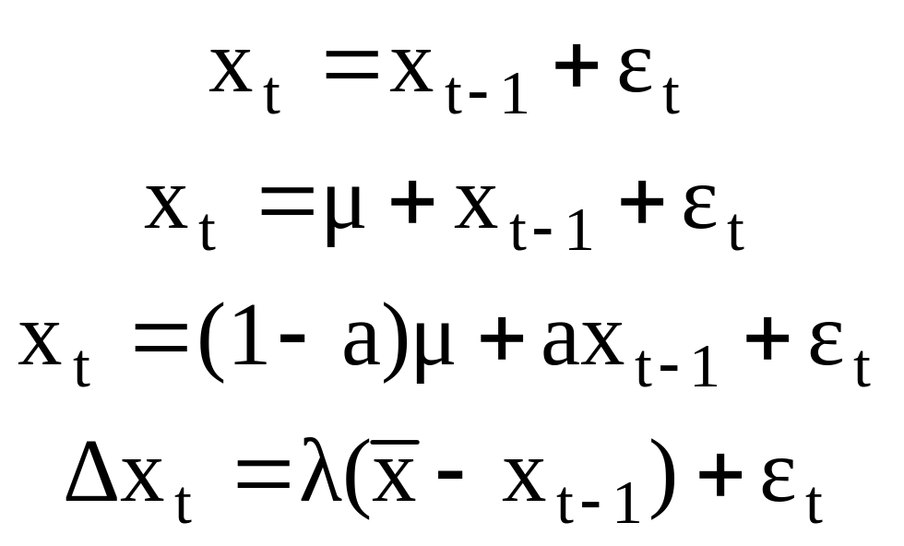
Examples of (Discrete-Time) Markov Processes

Slide 7
Weak-Form Market Efficiency
This asserts that it is impossible to produce consistently superior returns with a trading rule based on the past history of stock prices. In other words technical analysis does not work.
A Markov process for stock prices is clearly consistent with weak-form market efficiency

Slide 8
Example of a Discrete Time Continuous Variable Model
A stock price is currently at $40
At the end of 1 year it is considered that the change in its value will have a probability distribution of φ(0,10) where φ(μ,σ) is a normal distribution with mean μ and standard deviation σ.

Slide 9
Questions
What is the probability distribution of the change in the stock price at the end of:
• 2 years?
  • ½ years?
• ¼ years?
• δt years?
Taking limits we have defined a continuous variable, continuous time process

Slide 10
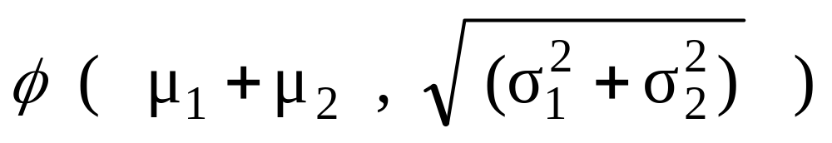
The distribution of x₃ is therefore:

Slide 11
Variances & Standard Deviations
In Markov processes changes in successive periods of time are independent
This means that variances are additive
Standard deviations are not additive

Slide 12
Variances & Standard Deviations (continued)
In our example it is correct to say that the variance is 100 per year.
It is strictly speaking not correct to say that the standard deviation is 10 per year.

Slide 13
A Wiener Process (See pp. 261-263)
We consider a variable z whose value changes continuously
The change in a small interval of time δt is δz
The variable follows a Wiener process if
1.
2. The values of δz for any 2 different (non-overlapping) periods of time are independent

Slide 14
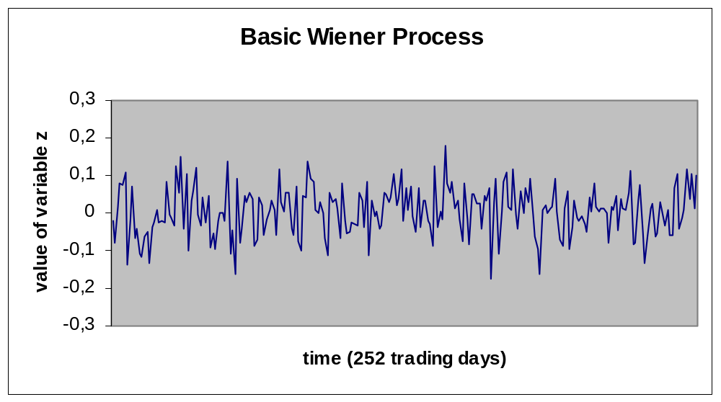

Slide 15
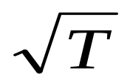
Properties of a Wiener Process
Mean of [z (T ) – z (0)] is 0
Variance of [z (T ) – z (0)] is T
Standard deviation of [z (T ) – z (0)] is

Slide 16
Taking Limits . . .
What does an expression involving dz and dt mean?
It should be interpreted as meaning that the corresponding expression involving δz and δt is true in the limit as δt tends to zero
In this respect, stochastic calculus is analogous to ordinary calculus

Slide 17
Generalized Wiener Processes
(See pages 263-265)
A Wiener process has a drift rate (i.e. average change per unit time) of 0 and a variance rate of 1
In a generalized Wiener process the drift rate and the variance rate can be set equal to any chosen constants

Slide 18
Generalized Wiener Processes
(continued)
The variable x follows a generalized Wiener process with a drift rate of a and a variance rate of b² if
dx=adt+bdz

Slide 19
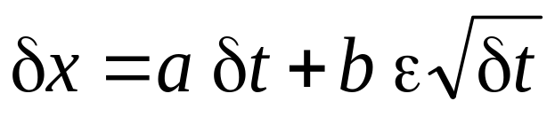

Generalized Wiener Processes
(continued)
Mean change in x in time T is aT
Variance of change in x in time T is b²T
Standard deviation of change in x in time T is

Slide 20
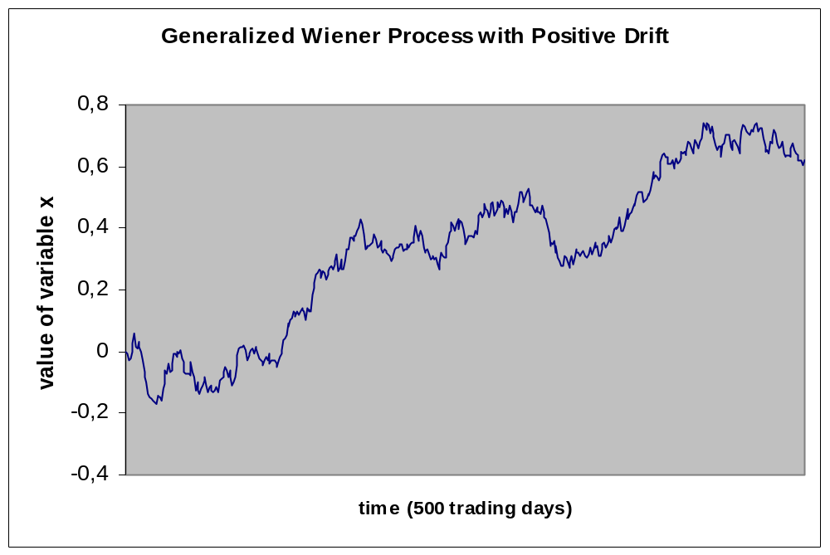

Slide 21
The Example Revisited
A stock price starts at 40 and the change in the stock price has a probability distribution of φ(0,10) at the end of the year.
If we assume the stochastic process is Markov with no drift then the process is
dS = 10dz
If the stock price were expected to grow by $8 on average during the year, so that the year-end distribution is φ(8,10), the process is
dS = 8dt + 10dz

Slide 22
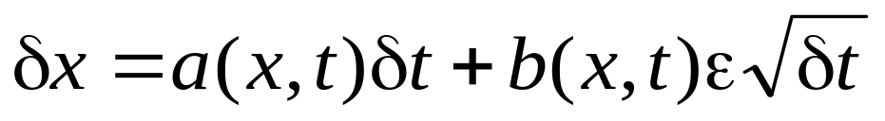
Ito Process (See page 265)
In an Ito process the drift rate and the variance rate are functions of x and time
dx=a(x,t)dt+b(x,t)dz
The discrete time approximation
is only true in the limit as δt tends to
zero

Slide 23
Why a Generalized Wiener Process is not Appropriate for Stocks
For a stock price we can conjecture that its expected percentage change in a short period of time remains constant, not its expected absolute change in a short period of time
We can also conjecture that our uncertainty as to the size of future stock price movements is proportional to the level of the stock price

Slide 24
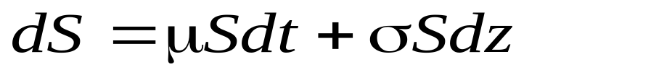
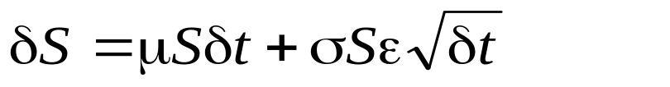
An Ito Process for Stock Prices
(See pages 265-267)
where μ is the expected return σ is the volatility.
The discrete time approximation is

Slide 25
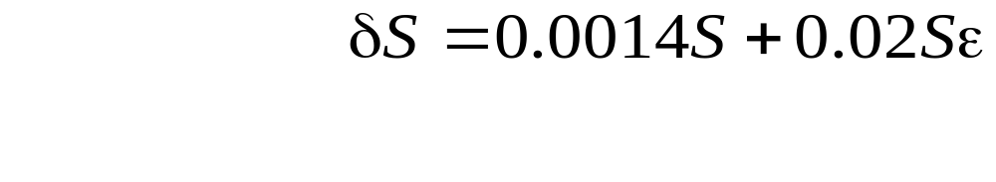
Monte Carlo Simulation
We can sample random paths for the stock price by sampling values for ε
Suppose μ= 0.14, σ= 0.20, and δt = 0.01, then

Slide 26
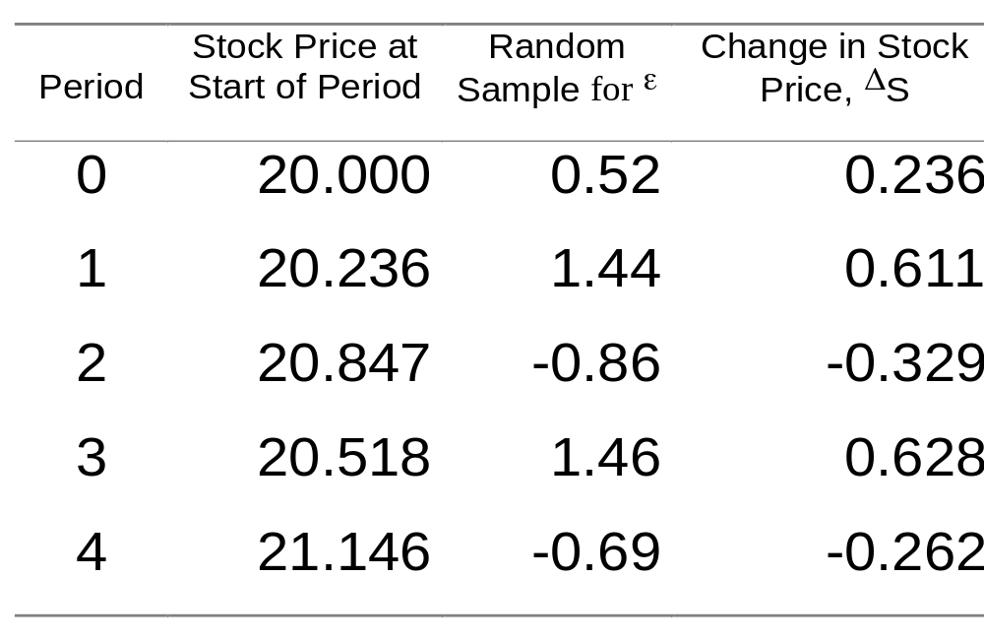
Monte Carlo Simulation – One Path (See Table 12.1, page 268)

Slide 27
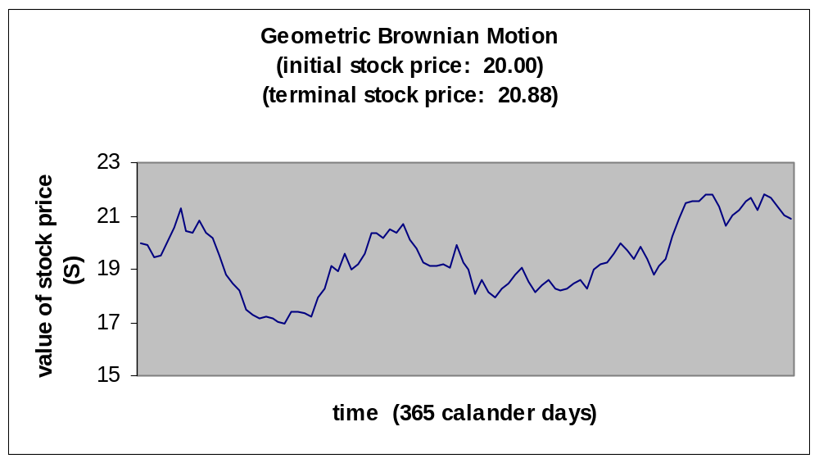

Slide 28
Ito’s Lemma (See pp. 269-270)
If we know the stochastic process followed by x, Ito’s lemma tells us the stochastic process followed by some function G (x, t )
Since a derivative security is a function of the price of the underlying and time, Ito’s lemma plays an important part in the analysis of derivative securities

Slide 29
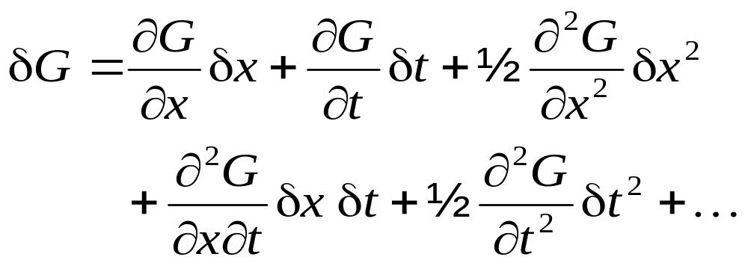
Taylor Series Expansion
A Taylor’s series expansion of G(x, t) gives

Slide 30
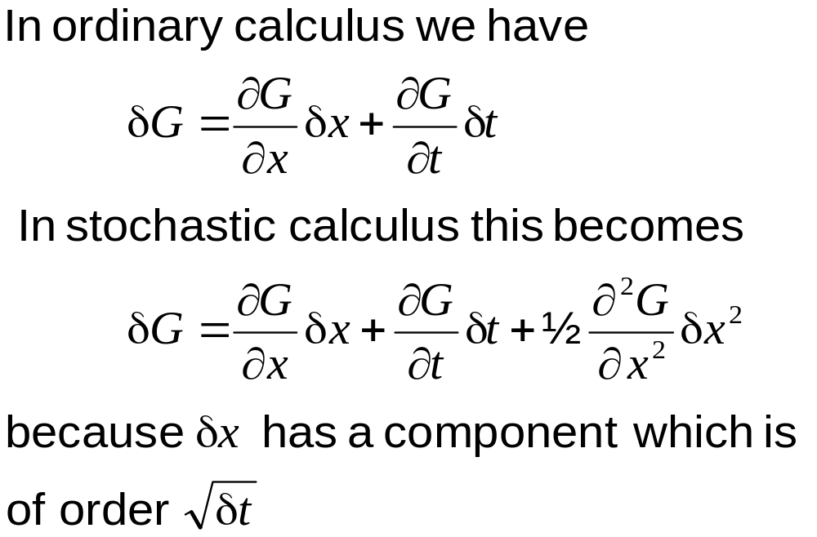
Ignoring Terms of Higher Order Than δt

Slide 31
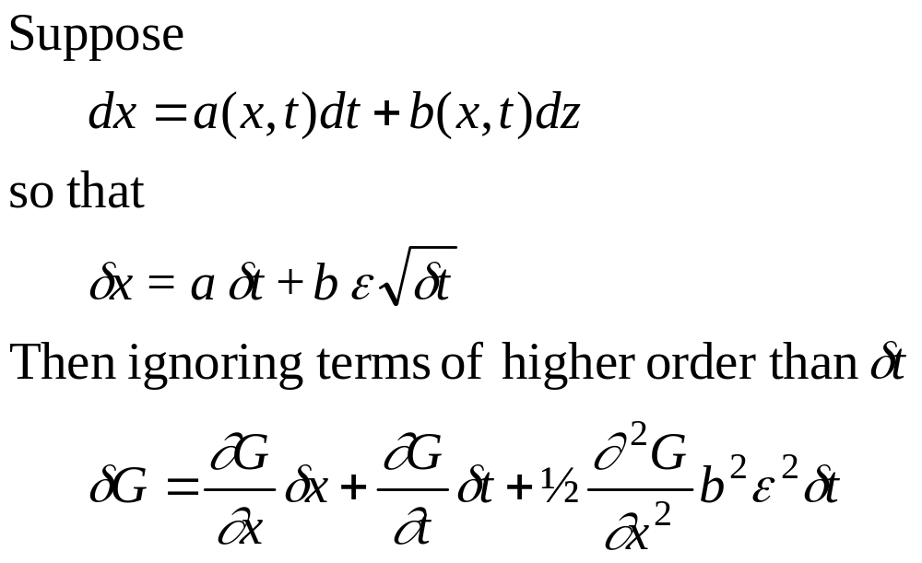
Substituting for δx

Slide 32
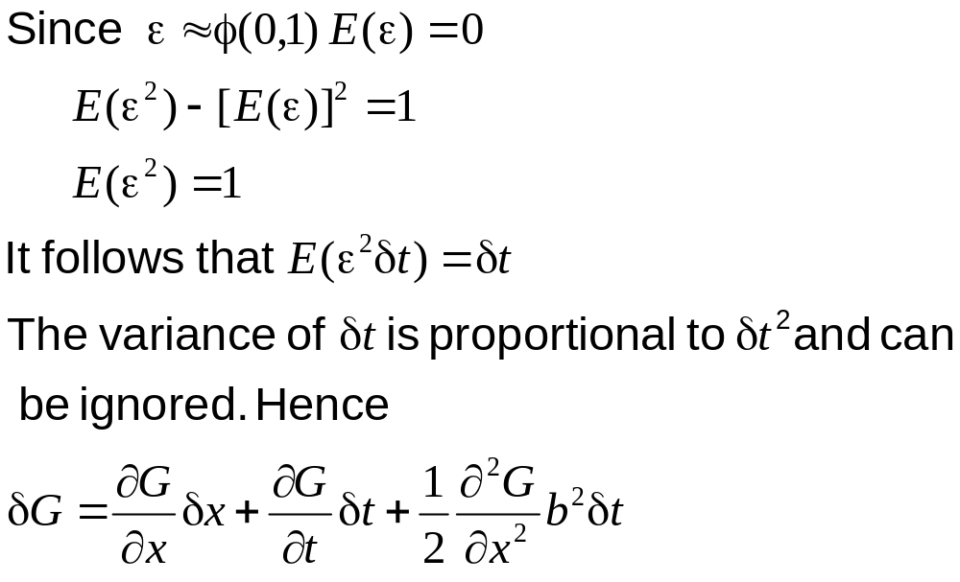
The ε²Δt Term

Slide 33
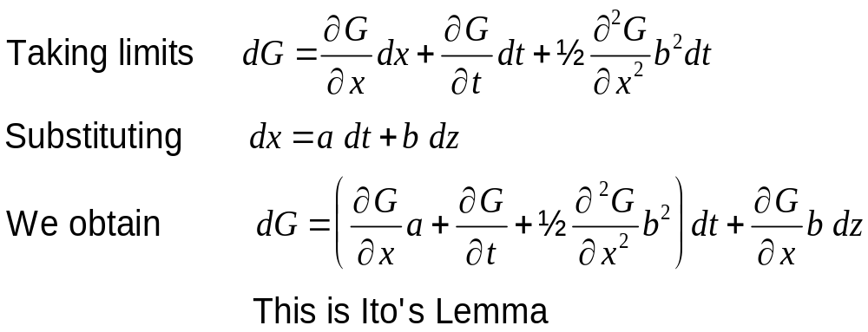
Taking Limits

Slide 34
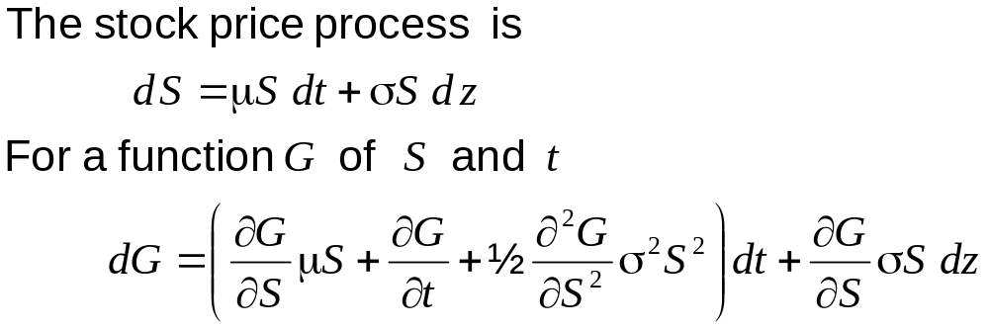
Application of Ito’s Lemma to a Stock Price Process

Slide 35
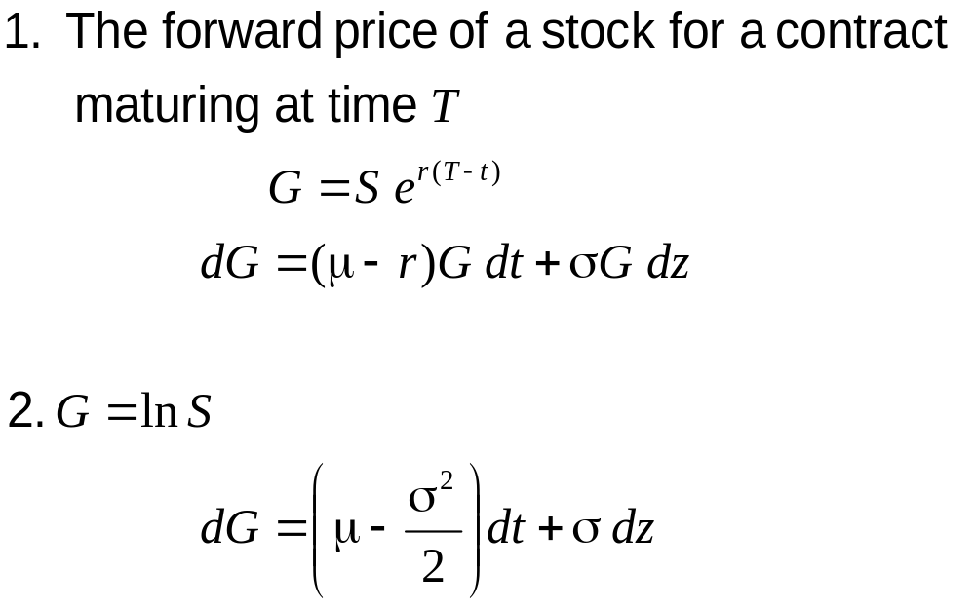
Examples

